Slide 1
Section 2.3
Problem Solving Involving
Max and Min
i) Revenue problems
ii) Maximum area
iii) Minimum for sums of two squares
© Copyright all rights reserved to Homework depot: www.BCMath.ca

Slide 2
I) Recap on What we Learnt so Far:
The vertex is for finding the Max/Minimum of something
The x-intercepts is when the height is zero
The y-intercept is when t=0 or x=0, height at the beginning
The axis of symmetry is the x-value or the time when an object is at the vertex (highest point) or lowest point
General form:
APQ Form:
Vertex:
A.O.S.
Axis of Symmetry
Y-int:
Plug this value into the equation to find the “y-value” for the vertex
X-int:
Y-int:
X-int:

Slide 3
II) applications of Quadratic Functions:
There are many applications of quadratic functions, anything that has to do with maximizing or minimizing a value
Finance and Business:
  Ie: Maximize Revenue and Profit
Construction and Infrastructure
  Maximize the area of a park, building, room
Coding and Programming
  Maximize efficiency: minimize the amount of resources to perform a task
In general, you will have two equations, plug one equation into the other to make a quadratic function
The quadratic function will be used the find the maximum or minimum of something: area, product,
Use CTS or XAV or -b/2a to find the vertex

Slide 4
III) Common terms:
Sum → Add , sum of two numbers is 10
Difference → Subtract, the diff. of two numbers is 8
Product → Multiply, the product of two numbers is a maximum value
Sum of their squares → Square the numbers & then add them, the sum of their squares is a minimum
Perimeter → length of all the edges, the perimeter of a rectangle is 200m
© Copyright all rights reserved to Homework depot: www.BCMath.ca

Slide 5
IV)Word Problems with Products and Squares
Ex: The sum of two numbers is 80. Their product is 1500. Answer the following Questions:
i) Write an expression for the two values
ii) Write an expression for the product
iii) Find the two numbers
iv) Suppose the product is a different value. What is the largest product that is possible?

Slide 6
Ex: The sum of two numbers is 80. Their product is 1500. Find the numbers
There are two numbers, let ‘x’ and
’80 –x’ be the numbers
Gather Information
80 minus the first number gives you the second nunber
The product is 1500
The two numbers are 30 and 80

Slide 7
d) Suppose we are looking for the largest possible product, use the product equation to find the vertex
So, if you have two values with a difference of 80, the largest product that you can have is 1600
The maximum product will occur if one of the values is 40

Slide 8
Ex: The difference of two numbers is 10. The sum of their squares is 60. Answer the following Questions:
a) Find an expression for the two numbers
b) Write an equation for the sum of their squares
c) Find the two numbers
d) Suppose the sum of their squares is not 60. What is the smallest possible value for the sum of their squares?

Slide 9
Ex: The difference of two numbers is 10. The sum of their squares is 60. Find the numbers
The second number is 10
more than the first
Gather Information
The sum of their squares is 60
The two sets of numbers are:

Slide 10
d) Suppose the sum of their squares is not 60. What is the smallest possible value for the sum of their squares?
Since we are looking for the smallest possible sum, find the vertex then
If two numbers have a difference of 10, the smallest possible sum of their squares is 50
The minimum sum will occur if one of the values is -5

Slide 11
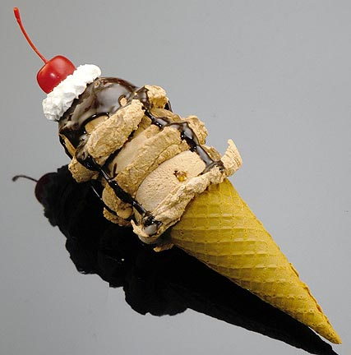
V) Maximizing Revenues in A BUSINESS!
When we increase the price of an merchandise, → Sales will decrease
In contrast, when we decrease the price → sales will increase
Revenue is the income generated from sales
In this lesson, we will learn to Maximize Revenue and Profit
Ex#1) An ice-cream shop sells 300 cones a day at $3.50 each. For every $0.50 increase, he loses 20 sales.
Q:How does the price affect quantity?
Q:How can the price be changed to generate the maximum revenue?
© Copyright all rights reserved to Homework depot: www.BCMath.ca

Slide 12
Analyze the question: Price vs Quantity
Sales begin at 300 cones per day
Initial Quantity:
Initial Price:
Change in Quantity:
Change in Price:
The initial price is at 3.50 per cone
Decrease of 20 cones in sales
Price is increased by $0.50/cone
The points can be used to make a straight line
Initial value
300
For every increase in 50 cents:
Use the slope equation to find how the price affects quantity
Sales will decrease by 20 units
200
For every change, a new set of coordinates will be created
3.5
4
4.5
5
5.5
© Copyright all rights reserved to Homework depot: www.BCMath.ca

Slide 13
a) How does the price affect quantity?
The x-axis corresponds with the price
The y-axis corresponds with the quantity
If we plug in the values and Isolate “Q”, we obtain an equation that shows how the price affects quantity
This equation shows how the
price affects the quantity
© Copyright all rights reserved to Homework depot: www.BCMath.ca

Slide 14
b) What price will generate Maximum Revenue?
Revenue = Quantity x Price
The points come together and generate a parabola
1400
1300
1200
1100
1000
900
800
700
600
The maximum revenue will be at the vertex (highest point on the graph)
500
400
300
Maximum revenue occurs when the price is at $5.50
200
100
1
2
3
4
5
6
7
8
9
© Copyright all rights reserved to Homework depot: www.BCMath.ca

Slide 15
Finding the Maximum Revenue
We can find the maximum revenue by CTS or XAV
The vertex of the revenue equation indicates the maximum revenue: x-coord: Price , y-coord: Revenue
CTS with the revenue equation
The Maximum revenue occurs when the price is at $5.50
The Max revenue is $1210
© Copyright all rights reserved to Homework depot: www.BCMath.ca

Slide 16
Ex#2) A Broadway Musical sells 3500 tickets a week at $25 per ticket. For every $1.25 decrease, 400 extra tickets will be sold.
Write “Q” as a function of “p”
Write “P” as a function of “Q”
Write “R” as a function of “p”
What price will generate the maximum revenue?
What Price will generate a Revenue greater than $80,000
Use this chart to generate the equation:
© Copyright all rights reserved to Homework depot: www.BCMath.ca

Slide 17
Write “P” as a function of “Q” (Isolate “P”)
Write “P” as a function of “R” and find the maximum revenue
The Maximum Revenue is $103320.31 and when the unit price is $17.97
© Copyright all rights reserved to Homework depot: www.BCMath.ca

Slide 18
What price will yield a revenue greater than $80,000?
y
Find the Intersection Point
1.2x10^5
10^5
8x10^4
For any price between $9.43 to $26.51, the revenue will be greater than $80,000!!
6x10^4
4x10^4
2x10^4
-2
0
2
4
6
8
10
12
14
16
18
20
22
24
26
28
30
32
34
36
38
x
© Copyright all rights reserved to Homework depot: www.BCMath.ca

Slide 19
To solve for the intersection points, make the Revenue equal to $80,000 and solve for the price
Isolate “P”
The Revenue will be greater than $80,000 if the price is between $9.43 to $26.51
© Copyright all rights reserved to Homework depot: www.BCMath.ca

Slide 20
Ex# A farmer wants to build a rectangular barn using 100 meters of fencing for his cows and chickens. However, he needs to separate the two groups of animals and needs to make the largest possible area. Determine the dimensions for the barn.
VI) Fence Problems - Maximizing Area
a) Draw a diagram showing how this barn would look like
b) Write an equation for the perimeter and the variables used to represent the length and width
c) Write an equation for the area of the barn
d) Determine the dimension of the barn and the maximum area
© Copyright all rights reserved to Homework depot: www.BCMath.ca

Slide 21
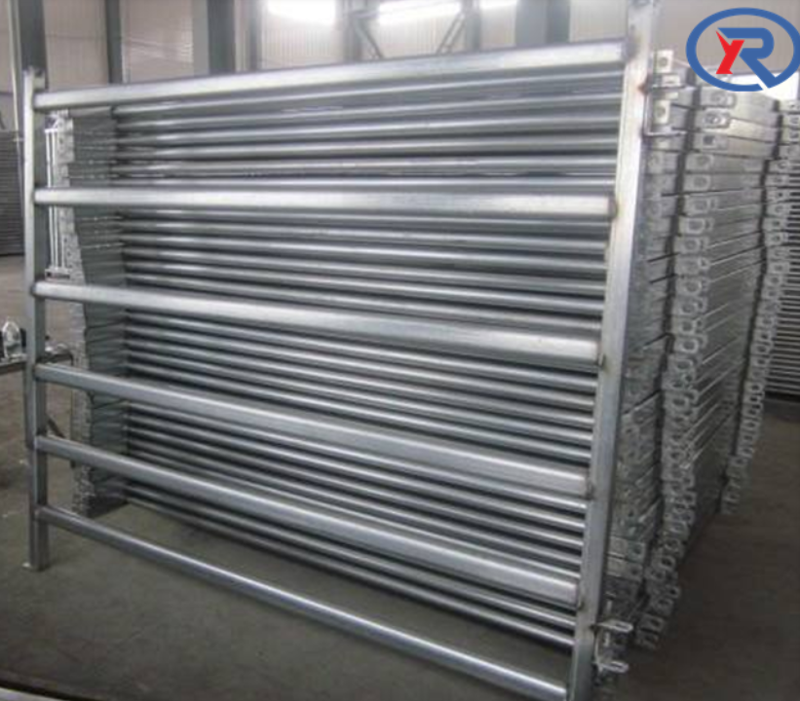
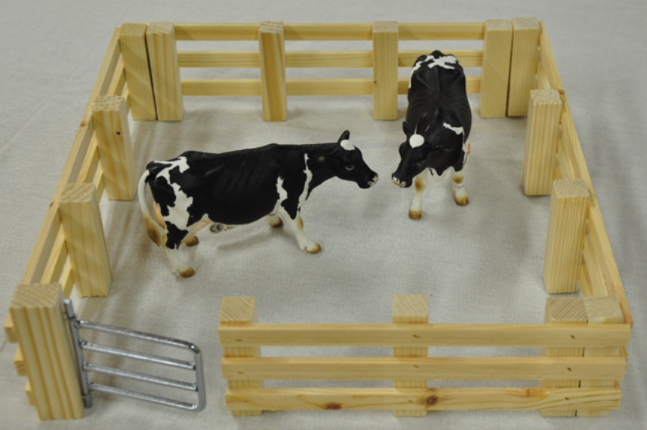
Isolate one variable
Complete the square
© Copyright all rights reserved to Homework depot: www.BCMath.ca

Slide 22






practice: Suppose you have 400m of fencing to build a rectangular garden as illustrated below, what are the dimensions of the largest possible area?

Slide 23
Ex: A farmer plans to build a giant rectangular enclosure with “m” rows of fence and “n” columns of fence. If there is 20,000 meters of fencing, then what is the maximum area of the enclosure in terms of “m” and “n”?

